Slide 1
27th August 2024
Use of HIV Self-Testing for Demand Creation of HTS
Trinidad and Tobago
Presented by: Brinnelle Kelly-Simmons, HIV/AIDS Coordinator,
HIV/AIDS Coordinating Unit, Ministry of Health
Trinidad and Tobago

Slide 2
History of HIV Self-Testing in Trinidad and Tobago
Initially rolled out in 2021- facilitated through the donation of 5,000 OraQuick Self-testing kits by the CDC
By the end of 2021, 1,192 kits were distributed through antenatal services. In February 2023, distribution was complete
The second phase of HIVST distribution began November 2023 and is currently underway
As at July 2024, a total of 2,172 kits have been distributed

Slide 3
National HIV Self Testing Algorithm
Perform HIV Self Test
Reactive
Non-Reactive
REPORT REACTIVE HIV SELF TEST
Refer for HIV Confirmatory testing.
If confirmed HIV-positive, refer for treatment
REPORT NON-REACTIVE HIV SELF TEST
Recommend retesting as needed. Advise linkage to relevant HIV prevention services

Slide 4
T&T’s Self-Testing Goal
Overall Goal
To increase access to HIV Testing in Trinidad and Tobago by providing an additional modality of testing - supplementing the traditional HIV Rapid (finger stick) testing - and meeting/surpassing the first 95 of the UNAIDS global targets (95% of persons living with HIV will know their status).

Slide 5
Specific Objectives
Objective # 1
Objective # 2
Objective # 3
Improve testing coverage amongst key populations (MSM, TG, FSW)
Facilitate partner testing
Increase demand for HIV testing

Slide 6
Our Target
1.3 Million
64 Thousand
Total Population of Trinidad and Tobago:
approx. 1.3 million
5 Thousand
Average number of HIV tests per year (based on the mean of the last 5 years)
64,000
HIVST Target
5,000

Slide 7
Our Milestones
2021
2022
2023
2024
OraQuick HIV Self-testing kit validated
HIV Testing Policy updated to include self-testing and SOP developed
5,000 test kits donated to T&T by CDC
50 HCWs trained in providing HIVST
1,192 kits distributed amongst antenatal care services
Trinidad and Tobago achieved the 1st 95 by the end of 2022
February - First phase of HIVST kit distribution complete
November - Commenced second phase of HIVST kit distribution
Decision made to expand Self-testing strategy to all Health Centres as well as 7 sexual health related NGOs
28 additional persons trained in HIVST

Slide 8
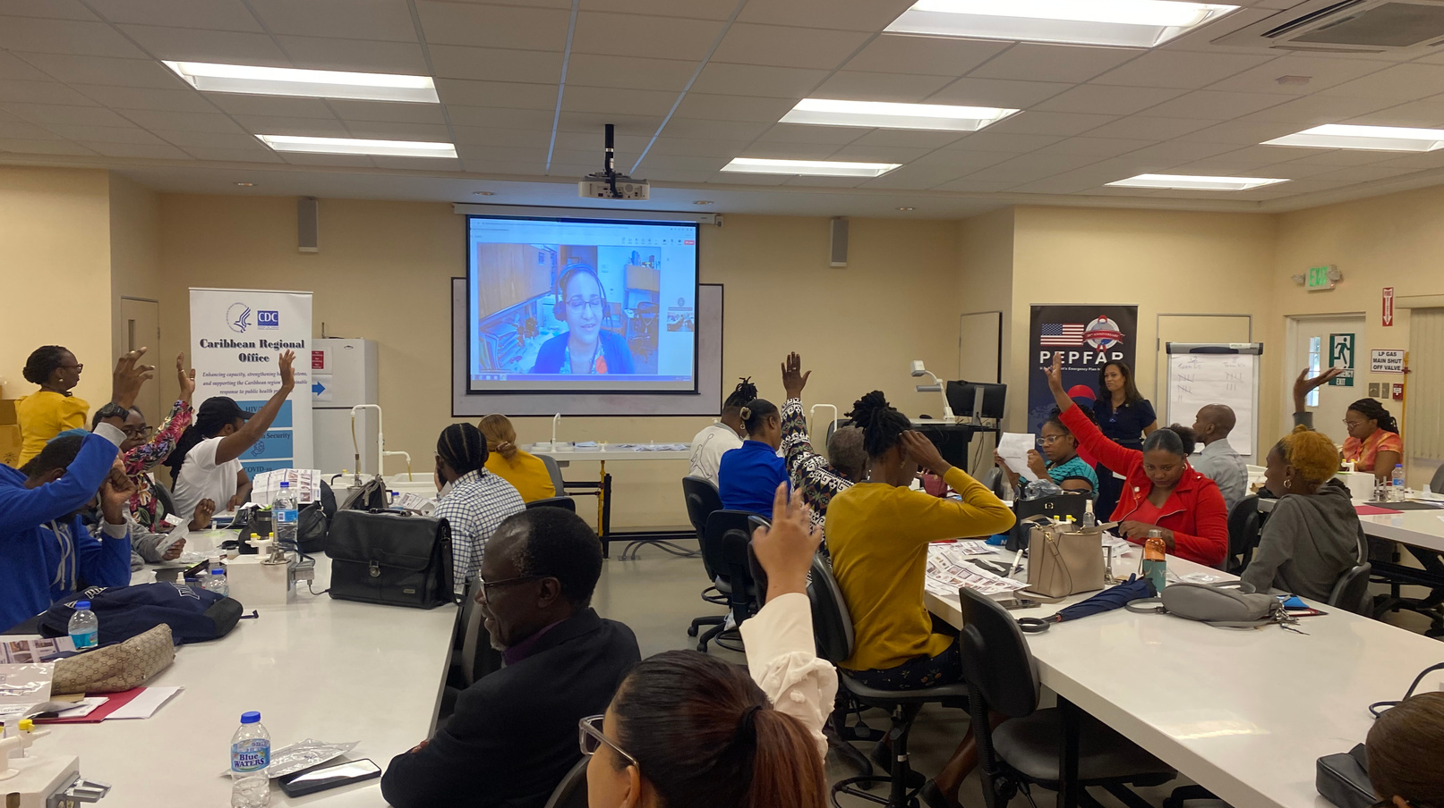
HIVST NGO Training
June 2024

Slide 9
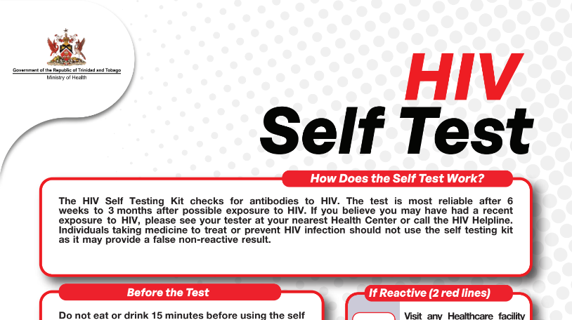
HIVST Material

Slide 10
HIVST Implementation

Slide 11
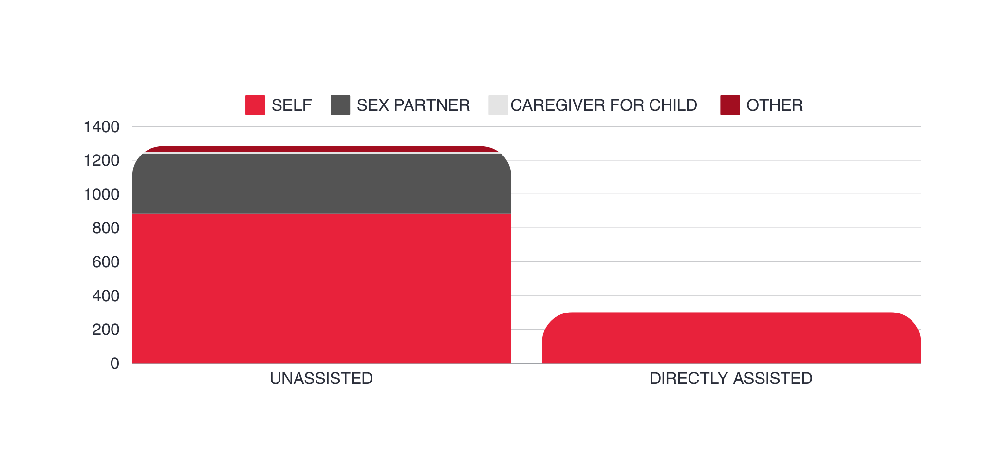
HIVST Implemenation
Assisted VS Unassisted Distribution
34
11
355
884
302
Data sourced from HACU HIVST June 2024 distribution and balance

Slide 12
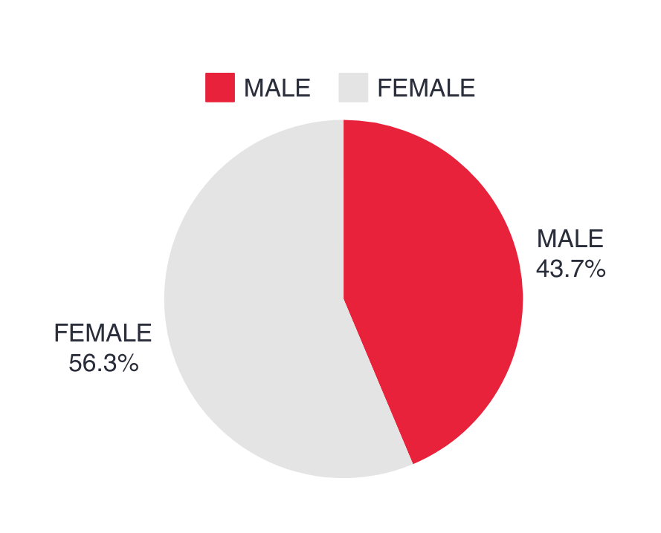
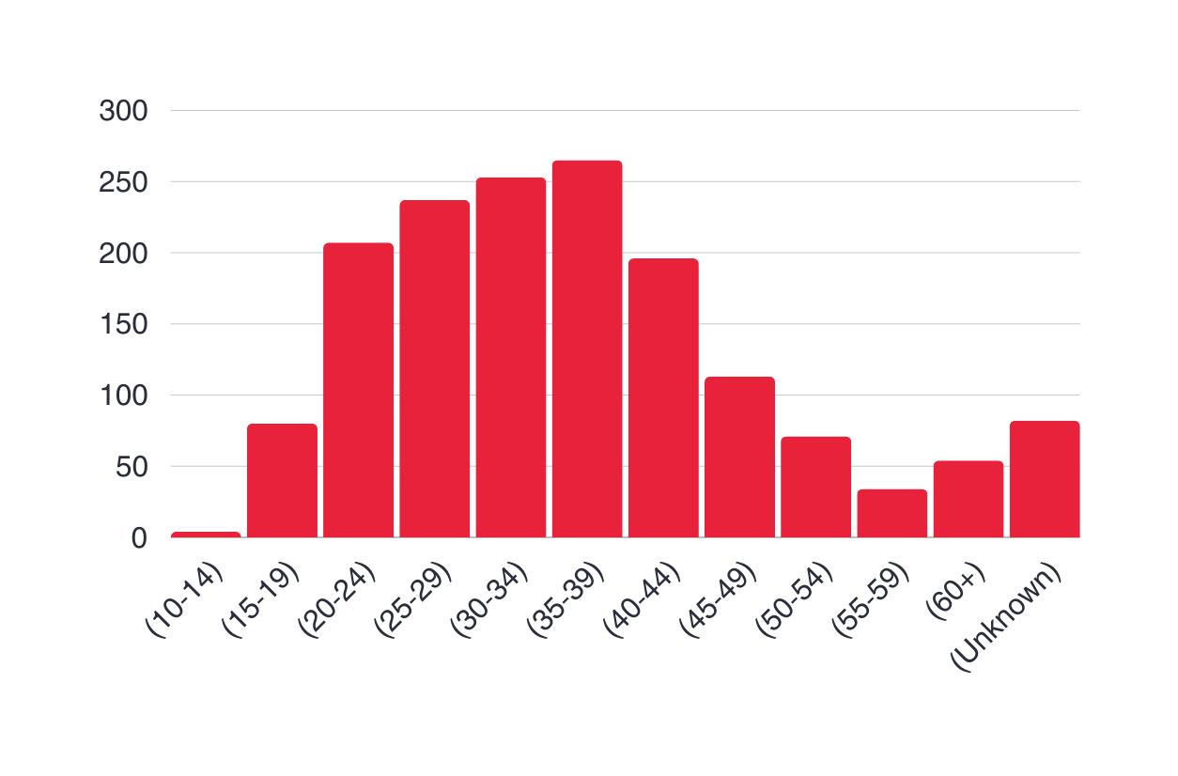
HIVST Distribution by Age & Sex
265
253
237
207
196
113
80
71
82
54
34
4
Data sourced from HACU HIVST June 2024 distribution and balance

Slide 13
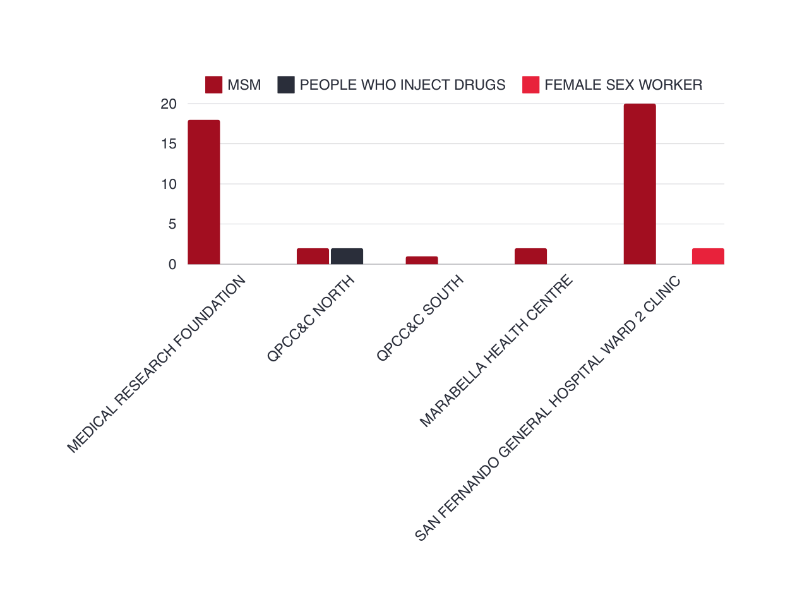
HIVST Distribution
Key Population Breakdown
43 MSM
20
18
2 People Who Inject Drugs
2
2
2
2
0
0
1
0
0
0
0
0
2 Female Sex Workers
Data sourced from HACU HIVST June 2024 distribution and balance

Slide 14
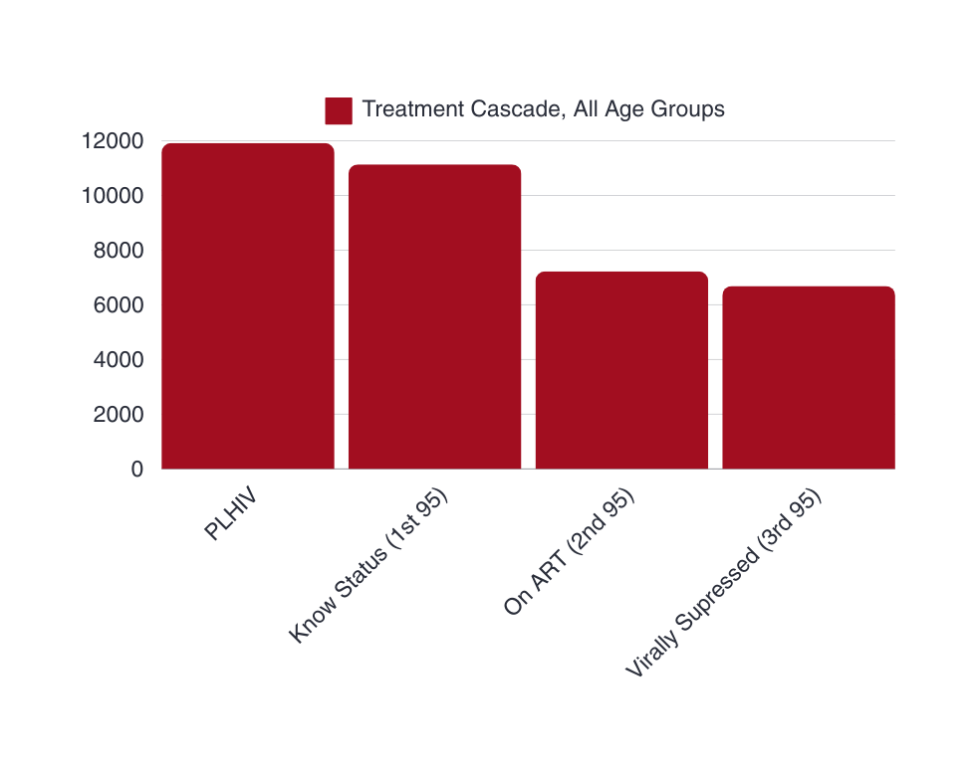
Treatment Cascade
Total number of persons who know their status
11,915
11,140
11,140, 95%
7,222, 65%
6,692, 93%
Total number of persons on ART
7,222
Total number of persons virally supressed
6,692
GAM 2023 Reported Data

Slide 15
Unintended Results
Result # 1
Result # 2
Result # 3
Slow initial uptake in the test kits
Large scale distribution at Outreach events
Increase in demand for HIV Rapid Testing

Slide 16
Conclusion
HIVST in T&T has increased access to HIV testing, thus increasing access to prevention and treatment services, especially to key populations
HIVST has increased the demand for HIV Testing, specifically HIV Rapid Testing
Unassisted self-testing was the preferred option for persons opting to self test
Through the expansion of HIVST distribution to all Health Centers and NGOs, T&T will meet its target of 5,000 HIVST kit distribution

Slide 17
Thank you!
Let’s collaborate!
Ministry of Health TT Website
www.health.gov.tt
Social Media (Instagram & Facebook)
@minhealthtt /
Ministry of Health - Trinidad and Tobago
Call us
868-217-4664

